Slide 1
Grails and rest
i.e. A web application backend in less than 2 hours
Notes:
Notes:
WRT Project Plan Page – there is an inconsistency between the slides and the webpage. On the webpage, it says that you need to write about only the new features (those suggested in Stage 0 feedback). In the slides it says you need to write details about ALL features. Let’s just stick with the new ones. The point is that we wanted you to think about how you might implement the suggested additions. All of your original features need to be specified in User Stories anyway.
Regarding UML and User Stories – we will cover these topics in class next week. Seriously, don’t stress too much about this. UML is hardly ‘standard’ and user stories are VERY informal.
On Wednesday, we will start by looking an example project and what user stories and UML diagrams you might extract from it.
Your UML/user stories are not going to be binding contracts. We just want to see what strategy you have taken when making decisions about class organization and interaction. Seeing how you’ve approached that part of the project will help us guide your progress in the next Stages.
I will release a marking scheme next week explaining exactly how you will be graded for Stage 1.

Slide 2
Prerequisites
Oracle JDK 8 (Don’t use OpenJDK)
Install JDK to accessible location
Set JAVA_HOME environment variable
Grails
IntelliJ Ultimate

Slide 3
Installing JDk (Linux)
Install Oracle JDK
Download jdk-8u121-linux-x64.tar.gz
Extract to /usr/java
sudo tar xf jdk-8u121-linux-x64.tar.gz –C /usr/java
Terminal: nano ~/.bashrc
Append:
export PATH="/usr/java/jdk1.8.0_121/bin:$PATH”
JAVA_HOME="/usr/java/jdk1.8.0_121"
If your Java version is different, adjust accordingly
Use CTRL+O to save and CTRL+X to exit
Close and restart terminal then test Java installation
Terminal: javac -version

Slide 4
Installing Grails
Terminal:
curl -s get.sdkman.io | bash
source "$HOME/.sdkman/bin/sdkman-init.sh”
Restart Terminal
sdk install grails
grails -version

Slide 5
Setting up IntelliJ IDEA Ultimate
Register ”Product Pack for Students”
Download IntelliJ IDEA Ultimate
Extract to a convenient location (e.g. ~/Downloads/ is fine)
Run ./idea-IU-163.11103.6/bin/idea.sh
Follow IDE setup with default settings

Slide 6
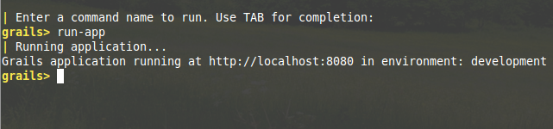
Creating a grails App
Create a directory called GrailsTutorial
Open Terminal at GrailsTutorial
grails create-app TaskList
Change directory to ./TaskList and run grails
Initial setup will take some time!
run-app

Slide 7
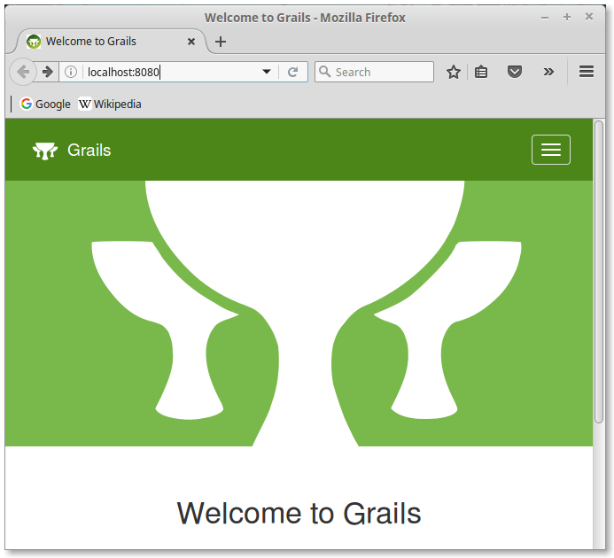

Slide 8
Congratulations!
You are now running a Grails server on your computer.

Slide 9
Tutorial Plan
In this tutorial, we will create a RESTful API and serve it to a React-based front-end.
REST (Representational State Transfer) allows programs to communicate with each other over the internet.
Combined with HTTP, a REST-enabled backend provides an interface that nearly any frontend can understand and interact with.

Slide 10
REST
https://www.openprogrammer.info/2015/01/16/legacy-code-agile-restful-application/

Slide 11
rest
POST
Used to create new resources, returns HTTP 201 with address to created resource
GET
Used to retrieve resources. Should not change server state. Returns HTTP 200 with data (usually XML or JSON).
PUT
Create or update resource. Returns HTTP 200, 201, or 204 with optional response body.
PATCH
Sends modification instructions to server.
DELETE
Deletes a resource and returns HTTP 200 with custom response body.

Slide 12
REST and Grails
Grails includes various strategies for enabling REST functionality.
The most basic is available via an annotation called @Resources
Automatically enables REST calls!
Creating a REST Controller is as easy as extending a class

Slide 13
Grails = Model + Controller ?
By implementing a RESTful API with Grails, we can effectively factor out Views from our Grails backend.
We can then use any programming language with HTTP capabilities to interact with our Grails backend and form a set of Views.
React, AngularJS, HTML, etc.
Or even plain Java/Python/C++
In a strange combination, you could use Grails to power a Java/Swing front-end.
This could be a contingency plan if you start with Grails and need to abandon a web frontend.

Slide 14
Creating Grails Components
Grails manages much of the structure of your code for you.
We can use command line tools or IntelliJ to create components.
IntelliJ must be properly configured with Grails and Gradle.
Our first application will be a simple Task List
This basic project will be extended/enhanced throughout the course
Code available on GitHub: https://github.com/ethamajin/TaskList

Slide 15
Creating Grails Components
Let’s create two Grails domain classes to serve as an example.
Domain classes are part of the model
Written in Groovy
Model classes can also be written in Java
Terminal:
grails
create-domain-class Task
create-domain-class TaskList
You should see confirmation messages like:
| Created grails-app/domain/tasklist/Task.groovy
| Created src/test/groovy/tasklist/TaskSpec.groovy

Slide 16
Creating Grails Components
Grails automatically generated test scripts that will be used later for validation.
Now let’s fire up IntelliJ to get a sense of our project structure.

Slide 17
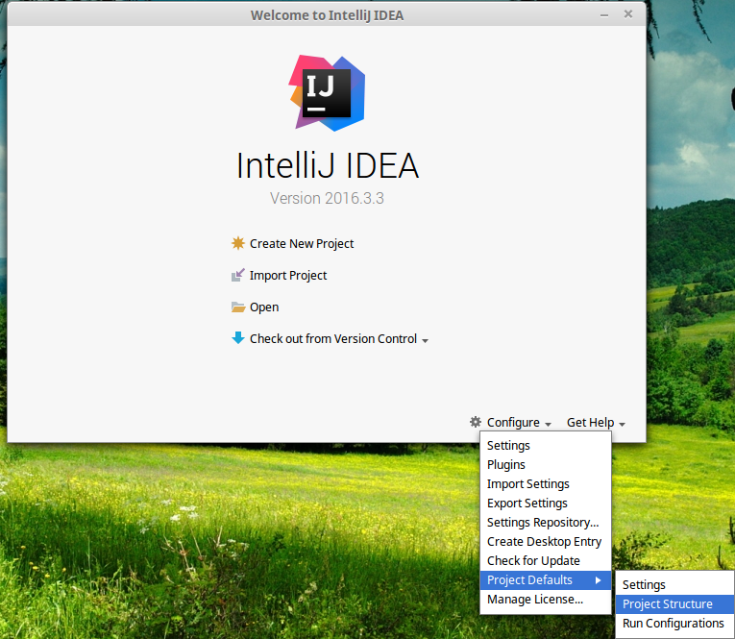
Notes:
The first thing we need to do is tell IntelliJ where to find Java by default. You would think that setting the JAVA_HOME environment variable would do the trick, but it doesn’t.

Slide 18
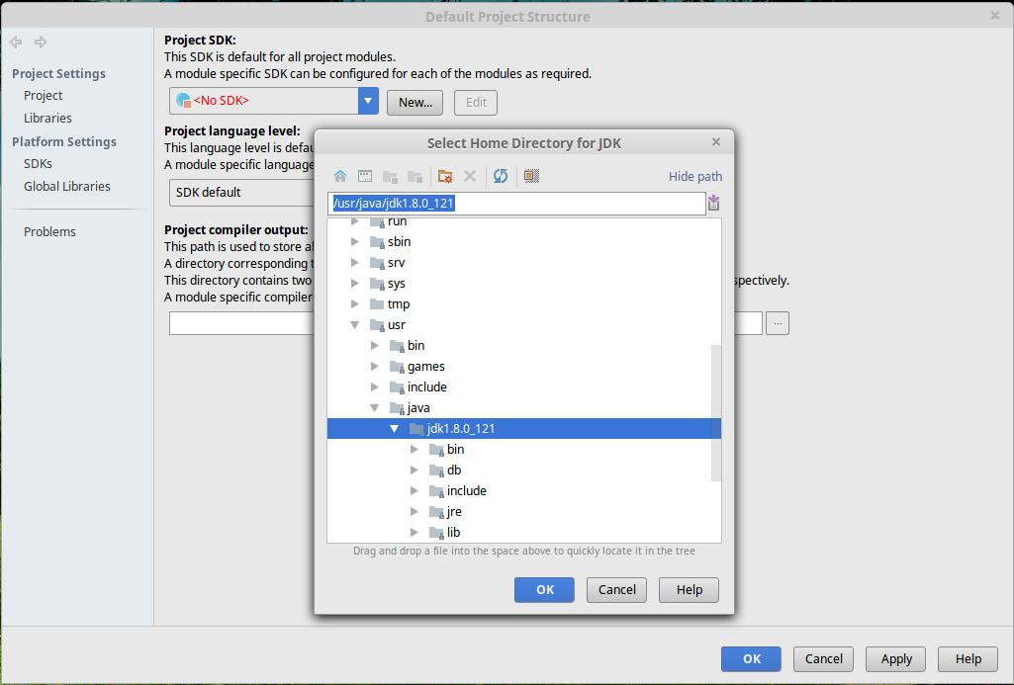
Notes:
Select the root directory of your JDK installation – not the bin folder.
Click OK.

Slide 19
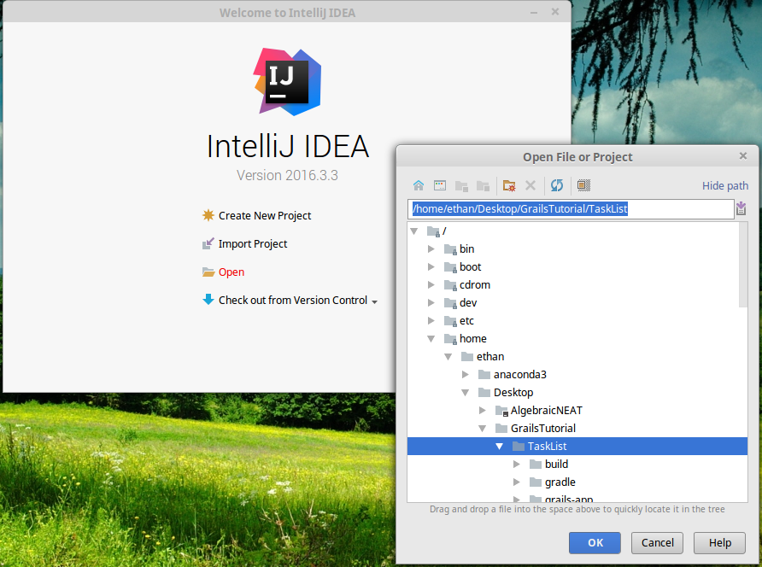
Notes:
Now open the root folder of your Grails project. IntelliJ knows to look for the build.gradle file to get project build directives.

Slide 20
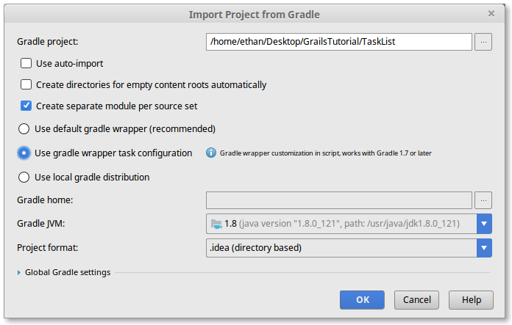
Notes:
Again, IntelliJ automatically determined that we’re trying to import a Gradle project.
Make sure your settings match the ones here.
Gradle gives us powerful build automation that will make sure all the right pieces are put into place when we run grails run-app.

Slide 21
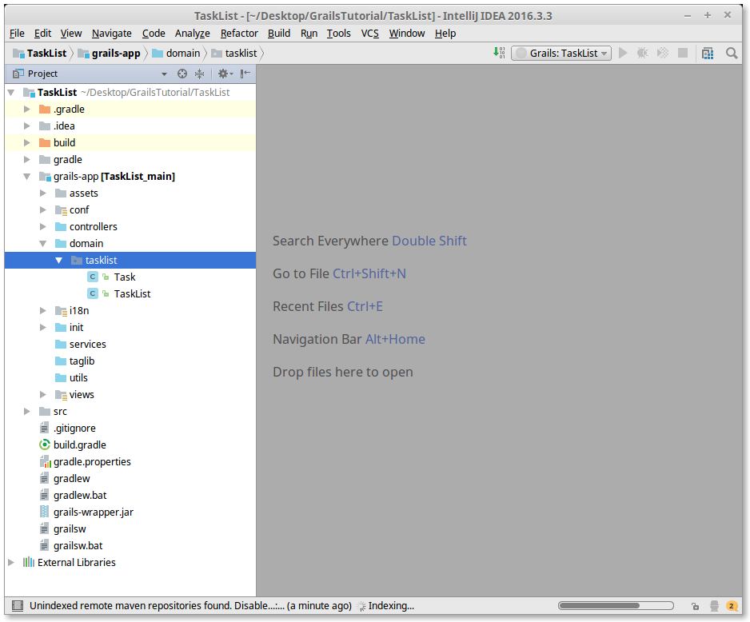
Notes:
Make sure the left sidebar in IntelliJ is set to Project.
Expand the file tree and find the two domain classes we created using the command line.

Slide 22
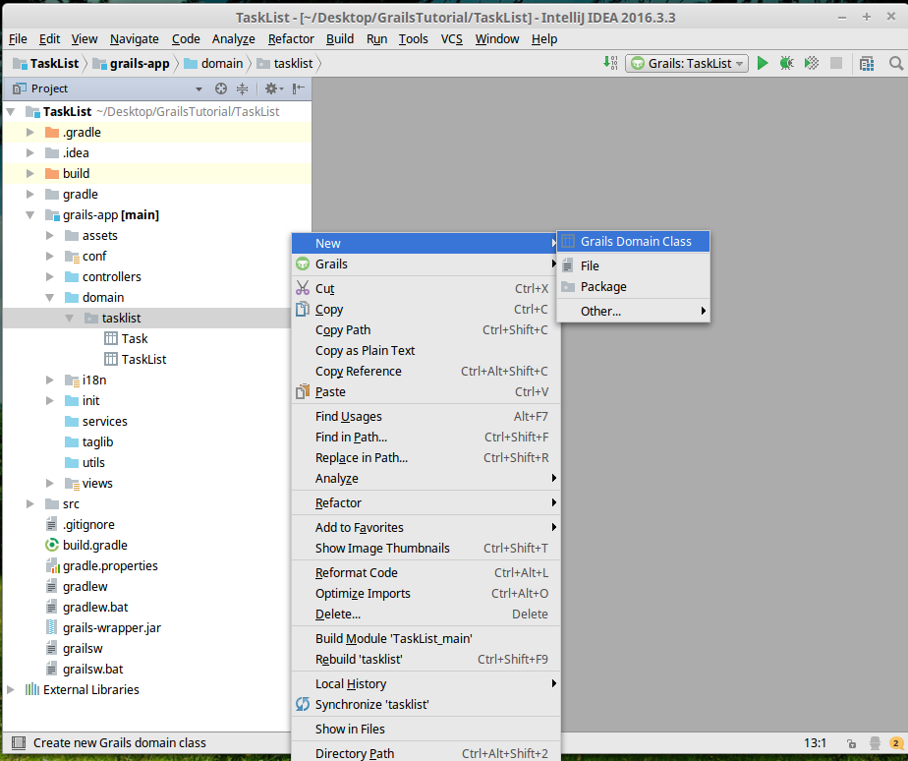
Notes:
Check your IntelliJ / Grails integration by right-clicking on the tasklist domain folder. Under new you should see a context-sensitive option to create a Grails Domain Class.
Don’t select this option. For now, we just wanted to check that the IDE integration is working nicely.

Slide 23
Groovy domain classes
Your data model can be implemented using Groovy domain classes
Groovy domain classes are very easy to write
You can use plain Java, if you prefer (not recommended)
Grails uses a data model called GORM - Grails Object Relational Mapping
During development, you can effectively use domain classes AS your database
More on this in another tutorial!
Let’s take a look at the Task class in ./domain/tasklist/Task

Slide 24
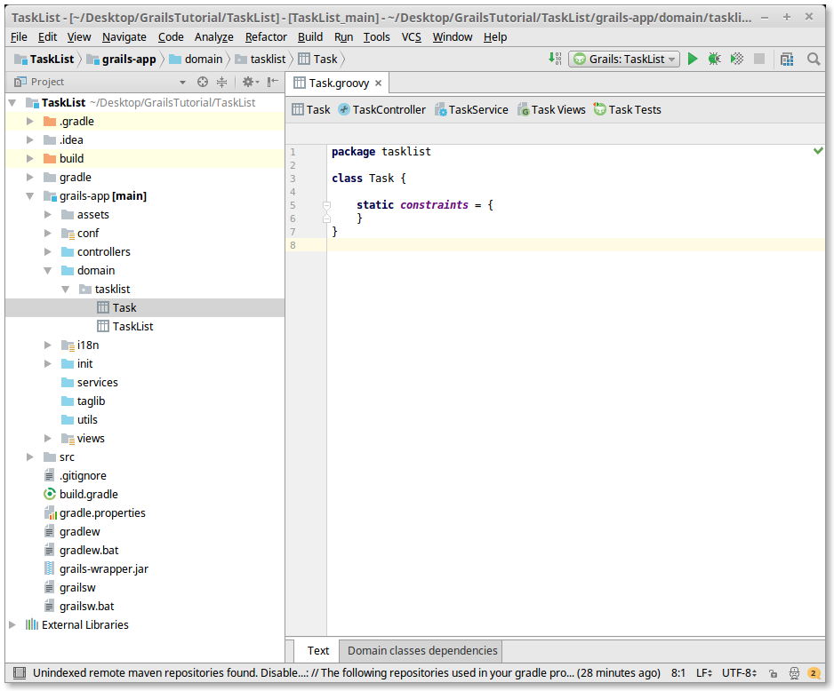

Slide 25
Groovy domain classes
We should already be familiar with package and class.
Analogous to Java constructs
static constraints{…}
Used to enforce data rules at the domain level
Similar to constraints in databases
E.g. password size : 5..20

Slide 26
Modelling Tasks and tasklists
Task objects will be simple objects consisting of a task name.
TaskList objects will consist of a name and 1 to many Tasks.
With Groovy/Grails, we can go further and define how these model classes relate to each other.
Very similar to relationship constraints in databases
Very similar to relationships/multiplicities in UML

Slide 27
Modelling Tasks and tasklists
package tasklist
class Task {
String name
static belongsTo = [taskList: TaskList]
static constraints = {
}
}
package tasklist
class TaskList {
String name
static hasMany = [tasks : Task]
static constraints = {
tasks nullable : true
}
}
Notes:
Here we are actually defining the relationships between the two domain classes.
These can be directly interpreted from your UML diagrams.
More details here: http://docs.grails.org/2.3.4/ref/Domain%20Classes/Usage.html
For more details about how model classes work, see this section of the documentation:
http://docs.grails.org/3.1.1/guide/single.html#GORM
In particular we will talk about them in the context of databases later on.

Slide 28
Exposing Model to REST API
Domain classes and Controller classes can have REST features enabled.
Let’s define a controller to work with our TaskLists
Whenever a controller is created, Grails will automatically create a URL mapping (if it doesn’t, check ./controllers/tasklist/UrlMappings)
Create a Controller called TaskListController
Right-click on ./controllers/tasklist/ > New > Grails Controller
URL http://localhost:8080/taskList/ is automatically generated and mapped
Notes:
https://docs.grails.org/latest/guide/webServices.html#restfulControllers

Slide 29
Creating a RESTful controller
In order to provide access to resources ‘under the hood’, we can make a Controller class a subclass of RestfulController.
class TaskListController extends RestfulController
By default, RestfulControllers will respond to HTTP requests using JSON.
By extending RestfulController, we can define custom methods that will be mapped to by URLs.
i.e. We are setting up methods that will be called remotely via URLs.

Slide 30
package tasklist
import grails.rest.RestfulController
// Inheriting RestfulController provides all the default REST methods.
// index, create, save, show, edit, update, delete
// are all available by inheritance.
class TaskListController extends RestfulController{
// We need to indicate how this controller will respond
// to REST calls - we will almost always use JSON.
static responseFormats = ['json', 'xml']
TaskListController() {
super(TaskList)
}
// respond with all tasks in JSON - all tasks on all lists
def getAllTaskLists(){
respond TaskList.findAll()
}
}
Notes:
Grails is full of convenience methods.
TaskList.findAll() will return all instances of TaskList in the domain.
This kind of built-in object mapping can be very useful for organizing data in your application!
http://docs.grails.org/latest/ref/Domain%20Classes/findAll.html

Slide 31
Initializing domain class data
In development mode, Grails maintains a kind of database of domain class instances in memory.
On launch, we can have Grails populate this database with domain class instances for testing.
Later on, of course, we will be configuring Grails to get this data from an actual database.
For now, let’s add code to our program that initializes the in-memory ‘database’.

Slide 32
Initializing domain class data
./init/tasklist/BootStrap.groovy
init method can be used to initialize domain objects

Slide 33
package tasklist
class BootStrap {
def init = { servletContext ->
// Looping sorcery - the variable 'it' corresponds to the iteration number
// The fields from the to-do domain class are assigned by label
// Initialize an empty task list
def myTaskList = new TaskList(name: "Ethan's List").save()
//Add 5 items to that task list!
5.times{
new Task(name: "Task ${it+1}", taskList: myTaskList).save()
}
}
def destroy = {
}
}
Notes:
Not again that you could have used a Java for-loop instead of the 5.times loop written here. You can almost always use Java code in place of Groovy code.

Slide 34
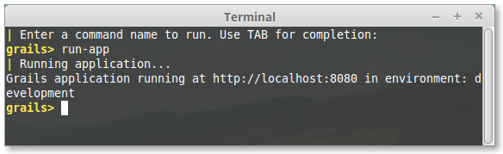
Testing our Controller
Now that we have domain objects, a controller, and some initial data, let’s fire up our first Grails application. Wait for the confirmation message!
Open your browser and navigate to http://localhost:8080/

Slide 35
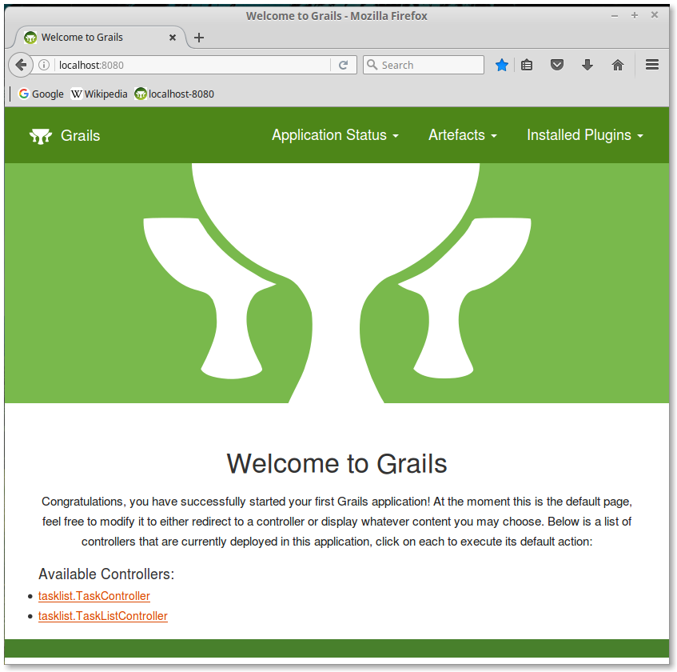
Notes:
Notice how we have some controllers already available!

Slide 36
Testing our controller
You can now test your REST-enabled controller class by calling one of its methods. So far we have only implemented one method called:
getAllTaskLists
and we can call it by entering the URL
http://localhost:8080/taskList/getAllTaskLists

Slide 37
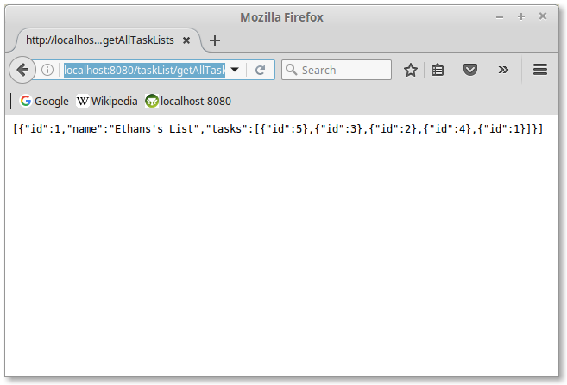

Slide 38
JSON
[{"id":1,"name":"Ethan's List","tasks":[{"id":5},{"id":3},{"id":2},{"id":4},{"id":1}]}]
This is a JSON (JavaScript Object Notation) object.
JSON is a very common format for transferring information between different computers and programming languages.
This JSON object represents a single TaskList that is composed of 5 Tasks.
Notice that the Tasks are only identified by id.

Slide 39
JSON and Rest
Your entire backend can be thought of as a program that implements a data model, performs computations, and communicates with external applications using JSON notation and REST methods.
Following this strategy, your backend will be able to serve nearly any imaginable frontend.
Let’s test some additional REST functionality.

Slide 40
sending information to Grails
Controller classes can also be used to receive information from URLs.
We can add the following method to our TaskListController:
def createTaskList(){
def name = params.name
new TaskList(name: name).save()
}
Then, after restarting Grails, we can create new TaskLists by calling
http://localhost:8080/taskList/createTaskList?name=AnotherList
Notes:
Multiple parameters can be specified using &
e.g. http://localhost:8080/taskList/createTaskList?name=AnotherList&initSize=5

Slide 41
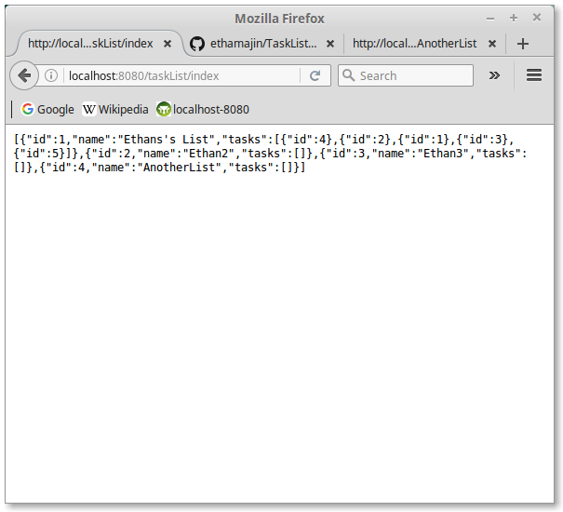

Slide 42
Next steps
Database Persistence
Unless you’ve cloned my GitHub repository, your Grails project will not save any data after the server is shut down.
We have many DB options available, but the simplest is built-in and transparent.
User Interface Components
In the next tutorial, we will create UI components using React/JavaScript to interact with our backend.

Slide 43
Planned tutorials
The following tutorials will have a graded component (submission on OWL)
git and GitHub
Command line tools, IDE integration, and GitHub features
Databases, Persistence, Querying
Querying techniques, refining a data model, enabling persistence in Grails
UI Tutorial 1: JavaScript/React and Grails
Primer on JavaScript/React components
UI Tutorial 2: Java / Swing
Basic UI for Java desktop applications

